Slide 1

HERC air emissions and impact on health

Slide 2

Until we get to zero waste, HERC is a better choice than landfilling for trash disposal
Located in the North Loop neighborhood in downtown Minneapolis
Operates 24/7
Processes 365,000 tons of waste per year
Owned by Hennepin County, operated by Great River Energy

Slide 3
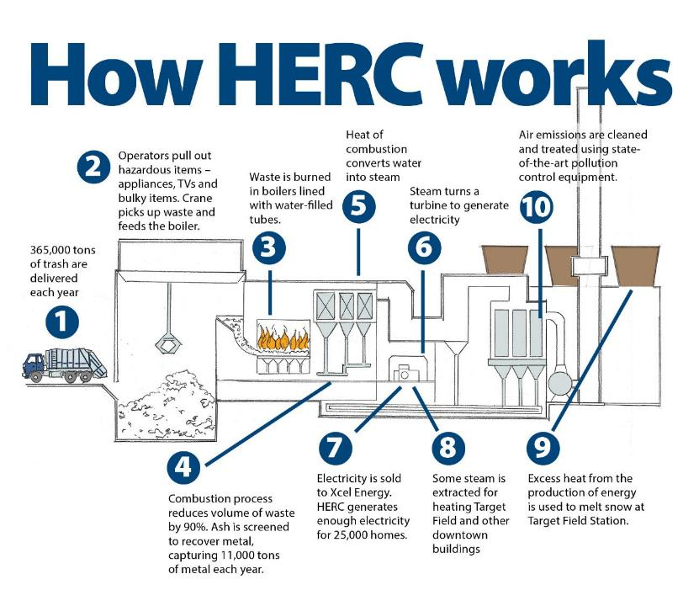

Slide 4
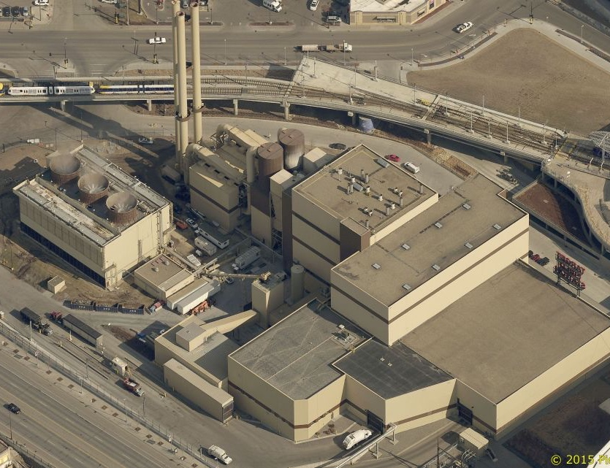
State-of-the-art air emission control technology
Fabric air filter baghouse
Urea is injected into the furnace to control nitrogen oxides emissions.
Powdered activated carbon is injected into exhaust gases to remove mercury & dioxins
Exhaust gases pass through a dry scrubber, where a hydrated lime slurry (alkaline) is injected to control sulfur dioxide and hydrogen chloride (acid gases)
Exhaust gases pass through fabric filters (3,328 bags, 8”x20’ ea) to remove particulate matter, metals and dioxins
Stacks
Acid gas scrubbers
Furnaces, boilers & turbine
Waste storage pit
& cranes
Cooling tower
Tipping hall
Ash storage
& load out
Notes:
The HERC facility employs state-of-the-art emission control technology to treat flue gases. HERC’s air permit requires it to operate under very stringent U.S. EPA and even more restrictive State of Minnesota air pollution regulations. The air emissions are also well below the European Union standards for waste-to-energy facilities.
All air emissions at HERC go through an air pollution control system to minimize and capture pollutants before discharge.
•Urea is injected into the furnace to control nitrogen oxide emissions.
•Activated carbon is injected to control mercury. HERC was the first waste-to-energy facility in the country to use activated carbon injection to control mercury emissions.
•Flue gases pass through a dry scrubber, where a lime slurry is injected to control sulfur dioxide and hydrochloric acid.
•Combustion gases pass through a baghouse containing a series of fabric filters to remove particulate matter, metals and dioxins.

Slide 5

Continuous monitoring
of emissions
Operator monitors combustion
Computerize
sampling
Notes:
Air emissions are monitored on a continuous basis for multiple pollutants.

Slide 6
HERC operates safely, minimizes pollution air emissions as percent of MPCA permit limit
Permit limit

Slide 7
Investing in emission reduction technology
Since 2015, the county has invested $3.8 million voluntary pollution control measures
NOx: Replaced the low-NOx system with urea system to reduce NOx emissions by 25% - $1.4 million (2015)
CO: Increased the size of the pre-heat coil in boiler 1 to improve combustion and reduce carbon monoxide emissions – $750,000 to complete boiler 1 in 2020.
Planning for same work on boiler 2.
Upgraded the Continuous Emissions Monitoring System (CEMS) - $850,000 (2016)
Installed a new state of the art system that continuously monitors stack emissions of SO2, NOx, CO2, CO, O2, and opacity.
PM: Refurbished the baghouse ($450,000) in 2019 and are currently evaluating new bags for longer life and additional emission reduction potential. Bags are replaced about every two years for operational efficiency.
HCl: The county is monitoring advancement in equipment technology for HCl.
No available technology has been found that is applicable to the HERC plant.
Hennepin County’s top criteria for evaluating capital improvement projects is improved environmental performance for our residents and the safety for our employees.
Staff routinely monitor for advancements in pollution control technology, focusing on Europe where waste-to-energy is used widely.
Engage with independent air emission technical consultants to assess pollution control technology.

Slide 8
Additional voluntary pollution control measures
Reducing NOx
Urea system:
Reduced NOx emissions by 25%
Equivalent to taking 10,000 – 15,000 cars off the road
Urea system installed July 2015

Slide 9
HERC mercury emissions
Fabric air filter baghouse
Stacks
Acid gas scrubbers
Installation of Activated Carbon Injection System for Mercury Control
Furnaces, boilers & turbine
MPCA Permit Limit (6/97)
100 ug/dscm
Waste storage pit
& cranes
Micrograms/Dry Standard Cubic Meter
Cooling tower
MPCA Permit Limit
(5/98)
60 ug/dscm
Tipping hall
Ash storage
& load out

Slide 10

BARR Engineering study: Evaluating the impact of HERC air emissions on our health
Conclusions:
The cancer and non-cancer risks from HERC emissions by themselves are well below Minnesota Department of Health incremental risk thresholds
Emissions from mobile and non–point sources pose much higher risks to human health than emissions from HERC
HERC is not likely to cause more harmful cancer or non-
cancer health effects in one part of the community than another (equally low impact on surrounding communities)
Notes:
We recently asked BARR Engineering to complete an evaluation of HERC air emissions on health. Because our time is limited, I am skipping to the end to the conclusions – but the remaining slides outline specifically their approach and source materials for the analysis. Others can now repeat this analysis, if they wish.
To summarize our findings, The cancer and non-cancer risks from HERC emissions by themselves are well below Minnesota Department of Health incremental risk thresholds. This result makes sense since as a permitted point-source facility, HERC is not allowed to emit pollutants in amounts that would increase cancer or non-cancer risks above incremental risk thresholds. MPCA would not issue a permit to HERC if they had data that said they did. This is why MPCA requires permits for point sources – to require the emissions controls to avoid an adverse health impact
The overall emissions in Hennepin County are dominated by mobile and non-point sources, which makes those sources more likely to have greater impacts on the total risk in the area. Our results only looked at HERC specific contributions, not all point source contributions to the total risk, however, the MPCA’s Understanding Environmental Justice in Minnesota website has it broken out by source type and in most census tracts, the primary source of the total risk is traffic emissions.
The overall impact from HERC’s emissions was negligible by itself, and especially when compared with the current background cancer and non-cancer levels.
HERC is not likely to cause more adverse cancer or non-cancer health effects in one population than in others (similar and low impact to all populations)

Slide 11
Evaluating the impact of air emissions on health
Emissions: pollutants released to the air
from numerous types of sources
Air quality: concentrations of pollutants
in the air we breathe
Risk: assessing potential health impacts associated with outdoor air quality
Notes:
When you see articles and opinions on HERC closing, the focus is typically on emissions – “HERC emits A, B, C pounds or tons of X, Y, Z – whether it be lead, mercury, nitrogen oxides, particulate matter, dioxin. These pollutants are linked to asthma, heart disease, increased risk of death from COVID.”
Emissions alone are part of the story. But not all of it because: a) people do not live at the top of the stack, and b) health impact is a complex function of how much pollutant are you exposed to, and what level of exposure results in health effects.
The MPCA uses tools like MPCA’s MNRisks to look at more direct relationships between emissions from a variety of sources and the associated health impacts, or risks.

Slide 12
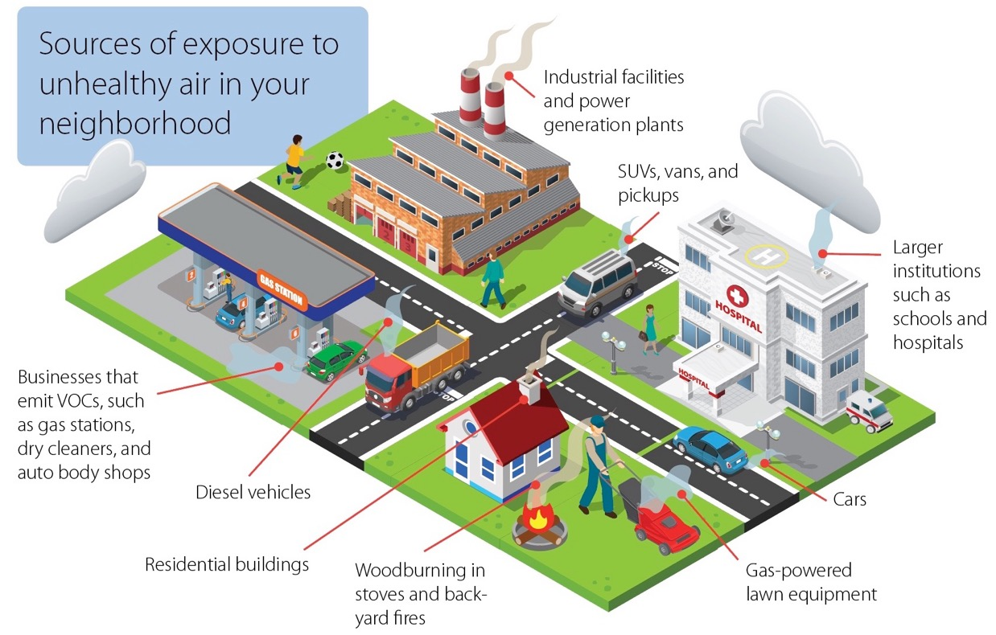
1. Emissions come from “sources”
www.pca.state.mn.us/air/neighborhood-sources
Notes:
This figure comes from the Minnesota Pollution Control Agency’s (MPCA’s) website. And it shows that there are a variety of emission sources in our neighborhoods.
There can be a variety of specific pollutants that come from each source. You can see that they often have an outlet point – a smokestack, a chimney, a tailpipe. But not always – like in the case of a backyard fire.
Emissions are typically measured on a mass per time basis – short-term as pounds per hour, grams per second, longer-term as tons per year or pounds per year.
They’re grouped into three main categories, 1) point sources
Facilities with air quality permits issued by
the Minnesota Pollution Control Agency
Most regulated of all source types (require
air pollution controls; testing and monitoring; recordkeeping and reporting)
HERC is a point source
In total, point sources produce less pollution than the next two types of sources we’ll cover
Non-point, Facilities too small to require a permit - by “too small” we mean not high enough emissions from any one facility, but there are a lot of them and collectively they produce a high amount of emissions.
Examples: gas stations, dry cleaners, asphalt paving, and industrial, commercial, and residential burning of fuel
Includes your home furnace, water heater and stove if they use natural gas. Also includes indoor fireplaces and outdoor fire pits, whether they burn natural gas or wood.
Mobile sources
On-road and off-road
Not individually regulated
Collectively produce a high amount of emissions

Slide 13
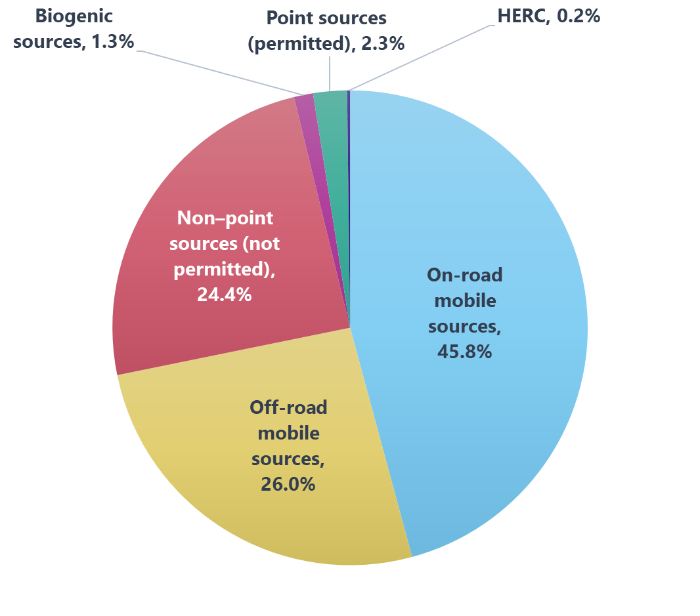
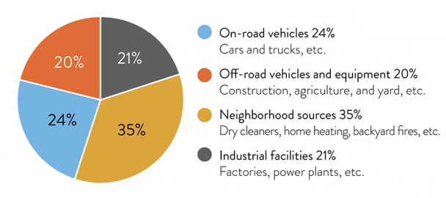
Minnesota and Hennepin County emissions by source
Emission-source percentages for entire state
Percentages for Hennepin County
www.pca.state.mn.us/air/sources-air-pollution
www.pca.state.mn.us/air/statewide-and-county-air-emissions
Notes:
The prior graphs looked at individual pollutants. This page summarizes for all pollutants.
Data comes from two MPCA websites, but it’s all based on emission inventory data.
The graph on the left, statewide, 79% of emissions are from sources other than point sources. In an urban/suburban area (HC), even where you probably have a higher proportion/density of the state point sources, total emissions are driven so much by the roads/traffic density, population, and commercial emitters, that the % from point sources from all point sources is 2.3%, HERC’s portion is only 0.2%.
So pollutant by pollutant, and across all pollutants, the contribution of HERCs emissions compared to total emissions is quite small.
Next I’m going to turn this over to Jenni to talk about what happens to emissions when they leave the stack, and what are the impact of those emissions.

Slide 14

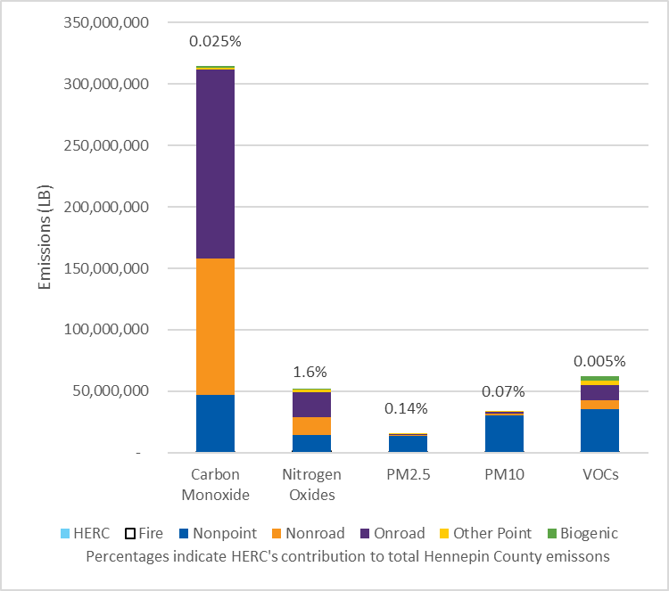
Comparison of HERC’s emissions of individual pollutants with other sources
Notes:
In this series of graphs, we compare HERC’s emissions of specific pollutants to other sources within the county.
The data is from 2017 and comes from two tools located on the MPCA’s website: “Permitted facility air emissions data” tool and the “Statewide and county criteria air pollutant and air toxic emissions”.
If you look at the key across the bottom, the source types build up from the bottom. So HERC’s contribution will be a light blue bar on the bottom of the stack. Pink is nonpoint, purple and green are mobile. The dark blue would be all point sources minus HERCs emissions. The percentage at the top is the percent of emissions that come from HERC compared to emissions of that pollutant from all sources.
This group of the pollutants are what USEPA and MPCA refers to as “criteria pollutants” and are most regulated.
PM10 and PM2.5 refer to fine particulate matter. The number is reference to the diameter of the particle sizes.
VOCs are volatile organic compounds. Compounds with high vapor pressures at room temperature. Formaldehyde, methylene chloride, trichloroethylene, acetone are examples. You’ll see in some other graphs that we can also look at these individually.
You can see that the bright red
portion of the bar doesn’t show up at the bottom because of the very low percentages from HERC.
Large majority of emissions are associated with mobile and non-point sources
Note the scale here is millions of pounds, or 10’s of thousands to 100’s of thousands of tons per year.

Slide 15
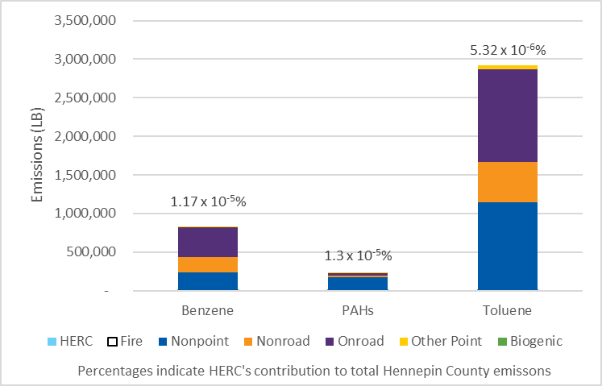
Comparison of HERC’s emissions of individual pollutants with other sources
Notes:
Two volatile organic compounds and polycyclic aromatic hydrocarbons (PAHs); are a class of chemicals that occur naturally in coal, crude oil, and gasoline. They also are produced when coal, oil, gas, wood, garbage, and tobacco are burned.
High-temperature cooking will form PAHs in meat and in other foods. Cigarette smoke contains many PAHs.
Again, emissions largely from mobile and non-point sources. HERC’s percentage is very small.
Scale here is hundreds or thousands of tons.

Slide 16
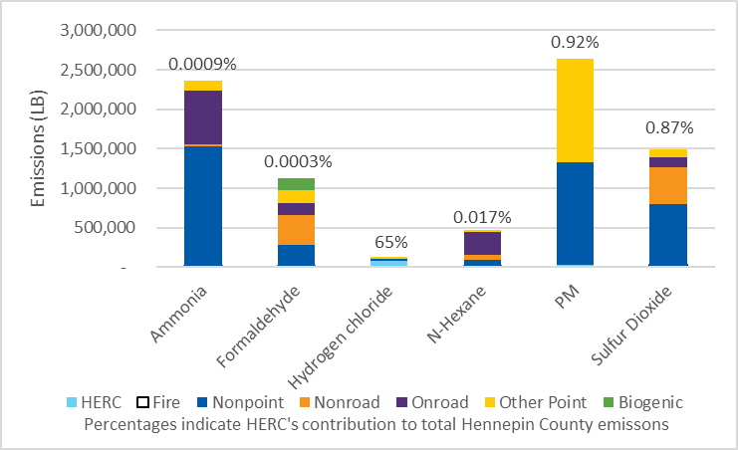
Comparison of HERC’s emissions of individual pollutants with other sources
Notes:
Hydrogen chloride is a pollutant that has a more significant portion of emissions from HERC compared to other sources. The red HERC bar here represents about 83,000 pounds.
HCl is a driver of non-cancer risk
Similar scale as the last slide

Slide 17
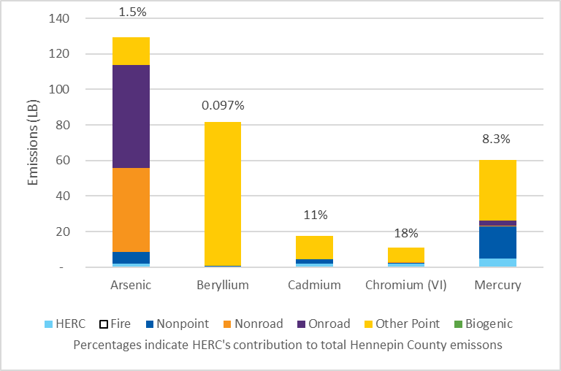
Comparison of HERC’s emissions of individual pollutants with other sources
Notes:
Some higher contributions from HERC to some metals
Note that scale here went from hundreds or thousands of tons to tens to hundreds of pounds.
Mercury emissions result from combustion of “Consumer products that contain mercury, like electronic devices, batteries, light bulbs and thermometers, that are thrown into garbage that is incinerated. The burning of municipal and medical waste was once a major source of mercury emissions. A reduction in the use of mercury along with state and federal regulations, however, has led to a decrease in emissions from these sources by over 95%.
HERCs Hg emissions were approximately 5 pounds in 2017.

Slide 18
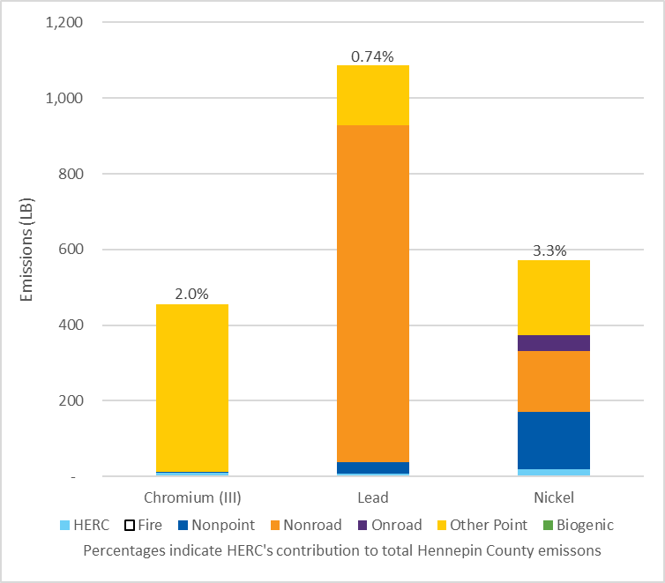
Comparison of HERC’s emissions of individual pollutants with other sources
Notes:
For these metals, relatively small portion.
Before unleaded gasoline was used in our cars, there was a green portion of the lead bar. But lead has been removed from onroad sources. The large nonroad portion comes from aviation fuel, so would be localized near airports.

Slide 19
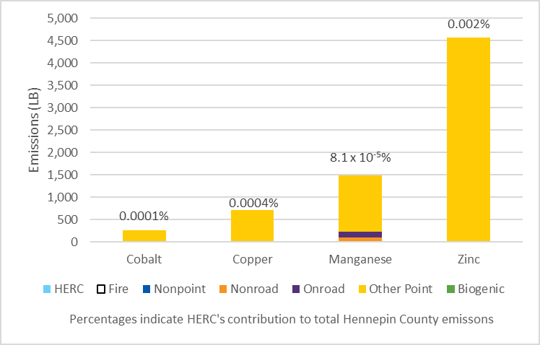
Comparison of HERC’s emissions of individual pollutants with other sources
Notes:
These metals primarily come from point sources other than HERC

Slide 20
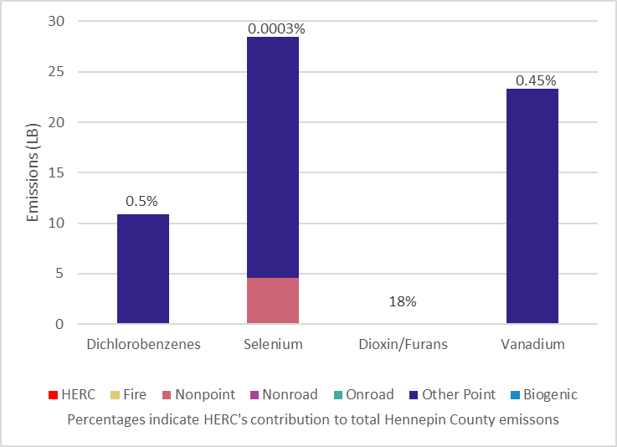
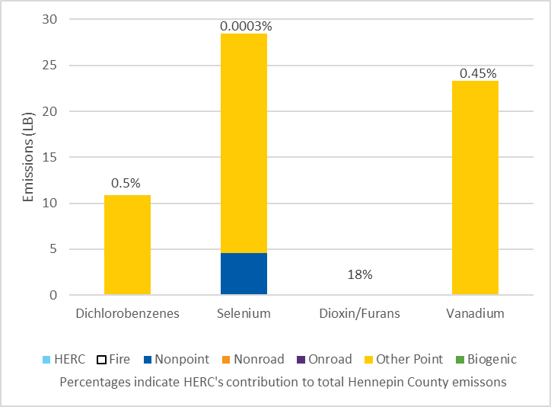
Comparison of HERC’s emissions of individual pollutants with other sources
Notes:
These pollutants also mostly come from point sources other than HERC.
Double-digit pounds here
You see 18% for dioxins and furans, but no visible bar. That’s because the total dioxins/furans are small fractions of a pound.
Next graph expands dioxin/furan

Slide 21
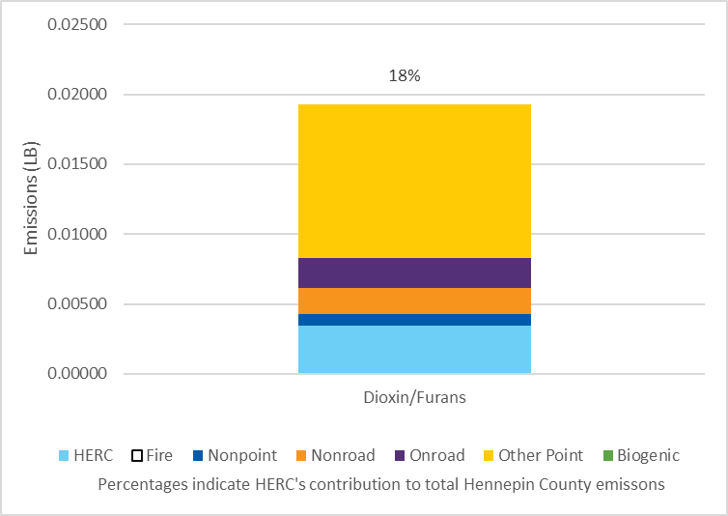
Comparison of HERC’s emissions of individual pollutants with other sources
Notes:
Dioxins and furans are a family of toxic substances that all share a similar chemical structure. Dioxins and furans result from the production of herbicides, from the pulp and paper industry, and when garbage and fuels are burned, or when foods are cooked. About 90% of exposure to dioxins and furans is from eating contaminated food.
HERC’s emissions are about one fifth of all dioxin/furan congeners emitted in the county. For 2017 that was 0.003416 pounds for the year.
The other small contributions are from combustion (for heating, to operate vehicles, backyard grilling).
Dioxins/furans are driver of both cancer and non-cancer risk
Note scale here – hundredths of a pound.

Slide 22
Dispersal
Air emissions disperse as a function of:
Release parameters
Atmospheric conditions
Land use
Emission rate
Emission temperature
Height of release
Wind speed
and direction
Air temperature
Atmospheric stability
Buildings
Vegetation
Terrain
Notes:
The way emissions spread throughout the surrounding air and environment is referred to as “dispersion” or “dispersal”. Emissions dispersion is influenced by source release parameters, atmospheric conditions or weather, and land use, both natural and humanmade. Release parameters describe how the emissions are released from a source; for a point source or stack like HERC, it is an opening at the top of a stack whose height, temperature and flow rate affect how the emissions disperse. Weather or atmospheric conditions are always changing and have a large impact on how emissions disperse. The speed and direction of the winds determine where and how far pollution will travel and atmospheric stability refers to low- and high-pressure systems that can affect the mixing of air vertically.
Based on all these factors, the effects of this dispersal can be quite variable. But at any given moment, you have emissions from a variety of sources, being dispersed by a variety of factors, collectively resulting in a concentration of pollutants at any particular point in the air where you have a “receptor”. Which could be you or me breathing that air.
Release or “stack” parameters – at the opening of the smokestack, chimney, tailpipe, etc. Atmospheric stability relates to low- and high-pressure systems that can affect the movement of air vertically. Buildings affect dispersal because wind generally can’t blow through buildings. Vegetation may affect dispersal differently when leaves are on trees than when they are not.
Some of these may be fairly static, like the height of release or emission temperature for a smokestack, or a building impact.
But others of these can be quite variable. Emission rate can change depending on what activities are occurring at the source. In the case of your car tailpipe, its location moves around all the time. Wind speed and direction can be quite variable, speeds tend to be less at night.

Slide 23

2. Air quality
All sources contribute to a
concentration of each pollutant:
  at a particular location (receptor)
  at a particular point in time
Each pollutant measured in mass per
volume of air, and varies over time
  maximum short-term concentration
  annual average concentration
Notes:
Air quality is the impact from all emission sources of a particular pollutant represented as a concentration at a location or (receptor) for a specified period in time. The air concentration at that receptor is affected by the 3 dispersion parameters (source release, atmospheric/weather, land use) mentioned earlier.
Air concentrations are measured in units of micrograms per cubic meter of air which is 1 1-millionth of a gram per volume of space that is one meter by one meter by one meter. Different pollutants have different averaging period standards which can be short-term (1-hour, daily) or long-term (annual) and can be evaluated as the highest measured or modeled impact over multiple years of data.
Maximum short-term would be the highest one-hour concentration at that location over 5 years

Slide 24
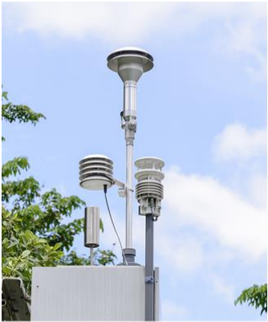
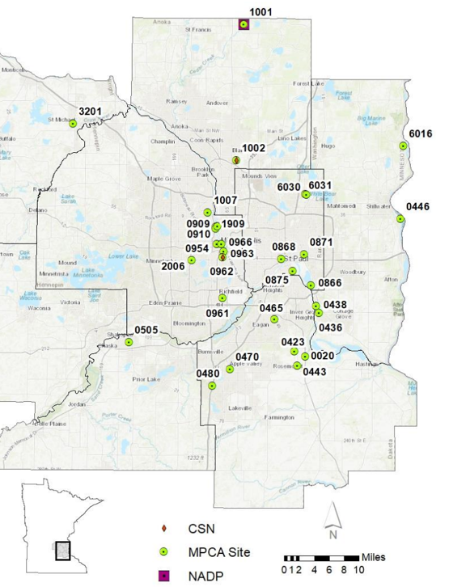
Air quality
Determining air quality (mass per volume of air) for a particular pollutant through:
  monitoring
  air dispersion modeling
June 2021 MPCA 2022 Annual Air Monitoring Network Plan for Minnesota
Notes:
Air quality can be measured using a monitor, or simulated using an air dispersion computer model. Monitoring collects actual air concentration measurements with on-site instruments. The picture on the left is an example of instrumentation at an ambient air monitor. The MPCA monitors multiple pollutants throughout the state and annually reviews the results and adjusts their monitoring plan as necessary. This report (Annual Ambient Monitoring Network Plan) and an interactive map of monitored data is publicly available on-line. The picture on the right shows monitor locations in the Twin Cities metro area. : www.pca.state.mn.us/air/minnesotas-air-monitoring-network
Monitoring is valuable because it gives you relatively accurate concentration measurements at a given location and averaging frequency. If a person lived outdoors at a monitor site that measured all pollutants, all the time, they’d have a really good idea about the air quality they are exposed to all the time. Unfortunately, ambient air monitors require a lot of cost, maintenance, and routine analysis which makes it cost prohibitive and impractical to site continuous monitors across every neighborhood in the state. This is why the location of the monitors we have is targeted at areas of known higher impacts (near large facilities and freeways) and in communities that have a history of disparate environmental impacts (environmental justice neighborhoods). So the alternative is to predict air quality at multiple locations using air dispersion modeling.

Slide 25
Air dispersion modeling
Used to determine pollutant concentrations
  Shows a particular source’s contribution to air quality at a specific location
  Shows how a combination of sources affect
  air quality
Modeled concentrations can be compared
to monitored concentrations to assess
model accuracy
Notes:
Air dispersion modeling is a computer program that uses math equations and numerical techniques to simulate the physical and chemical processes influencing air pollutants emitted from a source or group of sources and calculates how the emissions will disperse and react in the atmosphere. Models predict air pollutant concentrations at user selected locations called “receptors” which can number in the tens of thousands and extend 50 km or more beyond a source.
Monitoring and modeling are complimentary procedures, however, a modeling analysis allows for multiple receptor locations and an output with specific source or source group contributions to a specific location or air concentration result.

Slide 26
How air dispersion modeling works
Model uses five years’ worth of one-hour meteorological data to calculate the one-hour air concentration at a given location
From that, users can determine the:
  location with the highest one-hour concentration
  highest concentration at a specific location
  minimum, maximum, and annual averages for
  a certain location
Notes:
USEPA has an approved air dispersion model called AERMOD for regulatory use. This means that a facility that uses the model to determine their ambient air impacts and following approved EPA or state regulatory guidance has a reasonable assurance that the results are accurate. The model needs multiple inputs from the user including emission source locations and parameters (point, non-point source emissions), 5-years of hourly NWS weather data from a representative weather station, and receptor locations. The model allows you to decide the output format of the results to identify the maximum modeled air concentration location and the source contributions to that air maximum to identify which source has the greatest influence.
How well does it work? i.e., What do the monitored vs. modeled comparisons tell us about the model’s ability to predict the monitored/measured concentrations? It does okay. We accept the imprecision for the benefit of predicting many more locations. And we build conservatism into the assessment process to off-set the imprecision.
This is the standard regulatory modeling approach which is primarily used by USEPA and MPCA to determine a source’s contribution to local air quality (i.e., within 50 km of a source), and which is used here. Many other models exist for other purposes.
USEPA’s model of choice for these types of assessments is AERMOD – “a steady-state Gaussian plume model that incorporates air dispersion based on planetary boundary layer turbulence structure and scaling concepts, including treatment of both surface and elevated sources, and both simple and complex terrain”. Very complex and widely used to assess air quality.

Slide 27
3. Risk
U.S. EPA defines risk as the “chance of harmful effects to human health or to ecological systems”
Risk assessment estimates people’s increased risk of health problems as a result of breathing or ingesting a pollutant
Notes:
So far, we’ve discussed emissions and how they influence air quality which is a measure of the pollutants in the air we breathe. Air concentrations are measured using an ambient air monitor, or simulated using a computer air dispersion model. I want to point out that everything we are discussing follows the standard regulatory approach for evaluating air quality impacts from a source or sources.
How do we know whether those concentrations will cause a health issue or not? That brings us to the third term, risk
U.S. EPA = Environmental Protection Agency
Risk is the chance of harmful effects to human health or ecological systems. A risk assessment is an estimate of a person’s increased health risk as a result of breathing or ingesting a pollutant.
About Risk Assessment | US EPA and Human Health Risk Assessment | US EPA (because it was so audience-unfriendly, I replaced “Human-health risk assessment is the process of estimating the type and probability of adverse health effects in humans who may be exposed to chemicals in contaminated environmental media” with one adapted from https://engg.k-state.edu/CHSR/outreach/resources/docs/healthrisk.pdf.
Another option is “Human-health risk assessment is a way of estimating the potential impact of a hazard on the health of a person, group of people, or a community.” (https://www2.health.vic.gov.au/public-health/environmental-health/human-health-risk-assessments)

Slide 28
Risk
Cancer risk: The probability that a person will develop
cancer over their lifetime as a result of long-term exposure
to carcinogenic chemicals
Non-cancer risk: The highest level of exposure to a chemical that should cause no harmful non-cancer effects
Notes:
Risk assessments look at two different types of risk, cancer risk and non-cancer risk. Examples of non-cancer health ailments are asthma, or heart or kidney disease. Cancer risk represents the increased chance a person has of developing cancer over their entire lifetime. Non-cancer risk represents the level below which a person “should” experience no harmful effects. Some pollutants have cancer effects, some have non-cancer effects, some have both.

Slide 29
The four steps of risk assessment
Hazard identification
What health problems are caused by the pollutant?
Dose-response assessment
What are the health problems
at different exposures?
Risk characterization
What is the extra risk of
health problems in people
who were exposed?
Exposure assessment
How much of the pollutant
are people exposed to in a specific time period? How
many people are exposed?
www.epa.gov/risk/conducting-human-health-risk-assessment
Notes:
A risk assessment can be summarized in four steps. First, determine which pollutants can cause health impacts. Next, determine the minimum amount of the pollutant that causes a measurable health impact along with the length of time a person is exposed to the pollutant that results in a measurable health impact. With this information, the pollutant is assigned a risk value which is used in combination with the air concentration to quantify the potential health risk, either cancer or non-cancer.
Risk is dependent on a given exposure and how much of the pollutant people are exposed to which influences the resulting types of health problems. There are 4 steps that go into characterizing a total risk for a population. The first is identifying a specific pollutant’s potential health impacts or hazards. Once that is determined, scientific and clinical studies are conducted to identify the dose-response of that pollutant, or the amount of a pollutant that is hazardous to human health. Additionally, an exposure assessment identifies the length of time that is considered hazardous to human health for a given pollutant. Using all of this information, a risk characterization of the pollutant is quantified as a risk value to compare to a pollutant’s air concentration.
Risk is summed across pollutants and across exposure “scenarios”.

Slide 30
Scenarios considered
Residential exposure (at home)
Agricultural exposure (on a farm)
Fish-consumption exposure (eating fish)
Inhalation (breathing air that contains pollutants)
Consuming trace amounts of pollutants that settle from the air on soil, plants, or water
Notes:
A risk assessment looks at different exposure scenarios to determine a person’s total risk. It accounts for where a person lives, works, and spends their free time, as well as different pathways where a person is exposed to a pollutant; whether through breathing it in the air, or unintentionally ingesting it from local meat, fish, or vegetables.

Slide 31


Background vs. incremental risk
(Minnesota Department of Health)
Background:
45,000 in 100,000
Incremental
1 in 100,000 (1 x 10⁻⁵, 1E-05)
10,000 squares; each square
represents 10 people
Notes:
The total risk on an individual is made up of the background risk and an incremental risk. The background risk is a baseline that is just the make up of the general area. In Minnesota, we have approximately a 45,000 in 100,000 chance of developing cancer, or almost 1 in 2 people. The incremental risk is the additional risk a facility’s emissions add to the background risk. The incremental risk guideline value is based on policy decision and is used in all human health risk assessments to confirm that a facility’s emissions pose no significant additional increase of a person’s chances of developing cancer. The guideline value is 1 person in 100,000 or 1X10^-5. For example, a facility with impacts at the incremental risk guideline is like adding 1 additional person to the background of 41,000 in 100,000 or 41,001. If its impacts are less than that, say 1 in 1,000,000, it would add 0.1 to the 41,000 background.
Most major point sources (i.e. facilities) in Minnesota have completed human health risk assessments prior to approval of new major additions or modifications and regulators will not approve these changes without demonstrating that the full facility with the changes has an incremental cancer risk of less than 1 in 100,000.
Cancer risk – background (baseline) and incremental – “how much additional risk”
Background cancer risk based on data from MDH website and:
MDH 2018. Brief update on cancer occurrence in east Metro communities. Minnesota Cancer Reporting System, St Paul, MN. Brief Update on Cancer Occurrence in East Metro Communities (state.mn.us)
Background (baseline) cancer risk in Minnesota
Out of every 100,000 people, between 41,000 and 48,000 will get cancer, regardless of where they live or the work they do
Almost 1 in 2 people
Getting cancer doesn’t mean dying from cancer

Slide 32
Background vs. incremental risk
Background (baseline) non-cancer exposure
  Long-term (annual) non-cancer risk is 1.2
  Short-term (1-hour) non-cancer risk is 0.5
Incremental exposure guideline is 1
  If ≤ “1,” potential additional exposure considered acceptable
  If > “1,” additional assessment needed
Notes:
Non-cancer background risk varies depending on the season and time of year; but in general the noncancer chronic risk is slightly above 1 in the metro area regardless of where you are on a long-term time period. An incremental guideline value of 1 represents the minimum increase allowed by EPA and regulators to be protective of non-cancer health affects. Exceeding this level does not mean an adverse health effect will occur because an additional factor of safety or conservatism was taken into account when developing the guideline level.
Each pollutant with an identified non-cancer health impact can calculate the potential non-cancer exposure by dividing the pollutant air concentration by its health benchmark to get what is called a “hazard quotient”. Summing up all of the non-cancer pollutant hazard quotients results in a single total hazard index value which is compared to the incremental guideline of 1.
(prevalence of background risk from benzene, formaldehyde, and carbon tetrachloride; see slide on ambient air monitoring).
Incremental guideline value of “1” from USEPA; used by MDH
Exceedance of a guideline value does not mean adverse effects will occur.
Safety factors in developing a benchmark value (usually factor of 30 to 500) make it unlikely for exposure to ambient air to be a primary cause of “effects”.
Closest air monitor to HERC: City of Lakes location
Hazard quotient = air concentration / health benchmark (a ratio)
Hazard index = sum of Hazard quotients
Background hazard index is similar in Twin Cities and suburbs, Rochester, and Duluth due to traffic contributions.

Slide 33
Personal exposures vs. outdoor air
Periodic air-quality-monitoring studies across city
Outdoor (ambient) air
  Monitoring sites across Minneapolis have similar pollution levels
Personal exposures
  Indoor air has higher levels of some pollutants
    Formaldehyde: construction materials, cigarette smoke
  Routine activities can expose people to more pollutants than are in outdoor air
    Filling gas tank, riding bus, mowing lawn, cooking on gas stove, sitting near a fire
Notes:
Now that we’ve covered the different types of risk, I want to explain how an individual’s total risk is influenced by more than just background outdoor air. Outdoor or ambient air, is what the general public breathes when outside which is impacted by various point, non-point, and mobile sources that we measure using air monitors. Personal exposures are dependent on an individual’s choices and include both indoor and outdoor exposures. Indoor personal air exposures can come from the construction materials used in your home, or if you live in a home with an indoor cigarette smoker. Personal outdoor activities can also expose you to more potential pollutants on top of the background, like mowing your lawn, cooking on a gas or coal grill, or enjoying an outdoor fire. Choices people make and common things they do every day can expose them to potentially more pollutants than the outdoor air does.
(i.e., HERC affects health less than doing things you don’t think twice about)
Studies conducted by University of Minnesota, MDH, MPCA, and City of Minneapolis have consistently found the same levels of air pollution wherever samples were collected [in Minneapolis, or the Twin Cities, or the metro area?]
Critical point: Choices people make and common things they do every day can expose them to more pollutants than the outdoor air does (i.e., HERC affects health less than doing things you don’t think twice about)
References:
MPCA 2003. Personal exposure to PM2.5 in Minneapolis-St. Paul. Minnesota Pollution Control Agency, Environmental Bulletin. August 2003, Number 1. 8 pp.
MPCA 2003. Air toxics monitoring in the Twin Cities Metropolitan Area. Preliminary Report. Minnesota Pollution Control Agency, St. Paul. January 2003. 38 pp. (includes fine particles, VOCs, carbonyls)
MPCA 2016. 2013-2015 Community Air Monitoring Final Report. Minnesota Pollution Control Agency, St. Paul. MN. October 2016. 30 pp.
Minneapolis Health Dept. 2016. Air quality in Minneapolis: Neighborhood approach. Executive Summary. Minneapolis Health Department, Minneapolis, MN. Fall 2016.
Carbon tetrachloride is resistant to degradation and air concentrations likely reflect past emissions more so than current emissions. Emission reductions in CCl4 have occurred since the early 1990s but air concentrations have remained fairly constant; atmospheric lifetime of 30 to 100 years (NTP, NIH 2016)

Slide 34
Incremental risk guidelines
Calculated risk results are compared to the following facility risk guidelines developed by the Minnesota Department of Health, in accordance with U.S. EPA guidance
Total facility cancer risk below or at:
1 in 100,000 (1 x 10⁻⁵)
Total facility hazard index below or at: 1
Notes:
State and federal regulatory standards and guidelines are intended to limit exposures to potential carcinogens from regulated facilities to very low risks, for example, one additional cancer diagnosis in 100,000 people with lifetime exposure. This level of cancer risk is purposefully many thousands of times lower than cancer risks that can be detected by epidemiologic studies or examination of community cancer rates.

Slide 35
MNRisks
Minnesota Statewide Screening of Human Health Risks from Air Pollution
Air toxics risk-screening tool
Modeling: air concentrations, soil, surface water
Last updated in 2014
Accounts for point sources, non–point sources, and mobile sources
Notes:
The data that we will be referencing for the risk results is the direct output from the Minnesota Statewide Screening of Human Health Risks from Air Pollution Modeling, or MNRisks. It is a statewide model incorporating all emission sources (point, non-point, and mobile) and uses an emission inventory database of actual emissions from 2014. The modeling looked at receptors throughout the entire state and calculated air concentrations for exposures from both breathing in the air pollution and from other pathways like ingestion of plants, fish, and meat from exposure in soil and waterbodies. MNRisks is scheduled to be updated with a more recent emission inventory to evaluate how our potential risks have changed.
“Minnesota Risk Screening” MPCA’s tool for evaluating risks in Minnesota resulting for a variety of pollutant sources
Soil and surface water concentrations are used in the Agricultural and Fish Consumption Exposures

Slide 36
MNRisks
Calculates risks for specific receptors
Assesses potential risks by individual health endpoints (e.g., cancer, non-cancer chronic)
Estimates of source and pollutant culpability
Compares model-estimated air concentrations to monitored concentrations
Provides for source-category comparisons
(point-source vs. traffic contributions)
Assesses environmental equity by incorporating demographic data
Notes:
MNRisks is a statewide modeling evaluation which assesses both cancer and non-cancer risks across the entire state. The model output provided by MPCA allowed us to identify specific point source contributions to a modeled receptor risk along with determining which pollutants were the largest contributors to a total risk. The results can be viewed as an “Air Pollution Score” on MPCA’s Environmental Justice tool. We used MPCA’s underlying risk calculations to look at HERC contributions in comparison to other air pollution sources.
Now that we’ve explained the important concepts of emissions, air quality, and risk, what does the data tell us about HERC’s impacts.
Define “receptor” as discussed
“Culpability” – which sources and pollutants “drive” the overall risk (like, how much of the blame or responsibility falls on a source or pollutant)

Slide 37
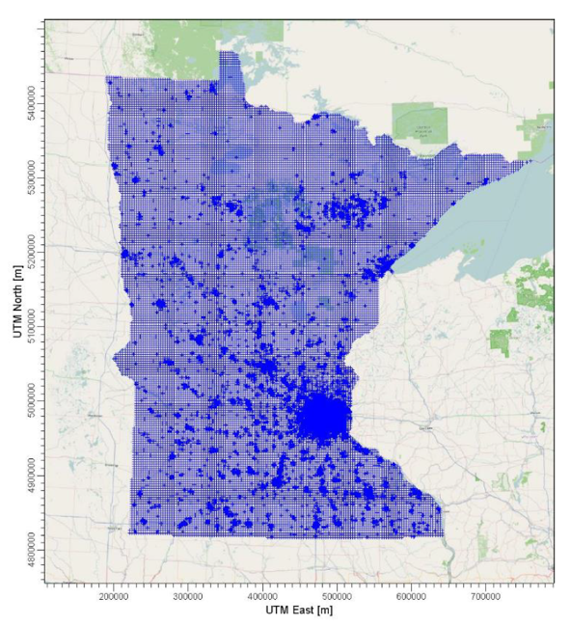
MNRisks modeled receptor locations
Notes:
The large image shows the MNRisks receptor grid superimposed on the environmental justice map, with HERC identified as a yellow star. The state map on the left shows the full MNRisks receptor grid for the entire state. Using the emissions data and dispersion factors, the model calculates the pollutant concentrations at each receptor location (purple dot). Statewide, there are about 65,000 receptors and the grid spacing is smaller in the metro area with greater population density and larger in greater Minnesota where the population density is much smaller. The air concentration outputs provided the highest 1-hour average air concentration, and the maximum annual average air concentration.
a. 3,000-meter spacing across the entire state
b. 300-meter spacing in the Metro area
c. At each Block group centroid (4,111 receptors)
d. A 300-meter diameter ring around point sources in the emissions inventory
e. Property boundaries for major facilities that have submitted model data information

Slide 38
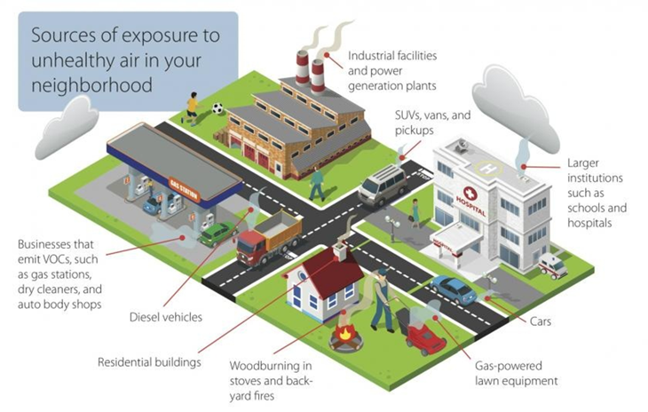
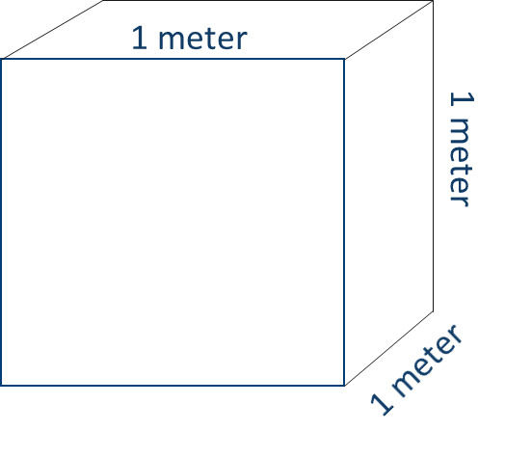
Model output for each receptor
Source 1, Pollutant a
Source 1, Pollutant b
:
Source 1, Pollutant n
Source 2, Pollutant a
Source 2, Pollutant b
:
Source 2, Pollutant n
:
Source n, Pollutant a
Source n, Pollutant b
…
(ug/m3)
Notes:
At each receptor location (purple dot) in the previous slide, the model calculates the highest one-hour and annual average air concentration of each pollutant from all source’s combined emissions. Each point (permitted) source has its own contribution, while non-point (area) and mobile sources contribute collectively in general areas which means we aren’t able to identify a specific mobile source or non-point source’s contribution to an air concentration. The purple circle represents a single receptor which represents an air concentration as a mass of a pollutant within a cubic meter. That pollution (ug) represents the sum of all source’s emissions of each pollutant. Then, each pollutant’s air concentration is compared to their cancer or non-cancer health risk guideline value and then all pollutants with a cancer health risk value are add together to get a total cancer risk at each receptor. The same goes for all pollutants with non-cancer health risk values, they are added together for a total non-cancer risk at each receptor.
You sum each pollutant across all sources to determine the total pollutant at that location. You can determine each source’s contribution to a total pollutant concentration at that location.
MNRisks also looks at what portion of the emissions is deposited to soil and water. These are used in the agricultural and fish-consumption scenarios.
Risk is calculated for a receptor by looking at the contribution of all pollutants (total from all sources) across all pathways. Because we have pollutant contributions by source, we can also determine a particular sources contribution to risk as a fraction of overall risk at that location.

Slide 39
Relative health impacts from HERC’s emissions
Risk is calculated for a receptor by looking at the contribution of all pollutants (total from all sources) across all pathways.
Use the analysis of pollutant contributions by source to determine a particular source's contribution to risk as a fraction of overall risk at a specific location.
Identified census tracks surrounding the HERC facility to understand HERC’s contribution to total risk at these locations.
Notes:
You sum each pollutant across all sources to determine the total pollutant at that location. You can determine each source’s contribution to a total pollutant concentration at that location.
MNRisks also looks at what portion of the emissions is deposited to soil and water. These are used in the agricultural and fish-consumption scenarios.
Risk is calculated for a receptor by looking at the contribution of all pollutants (total from all sources) across all pathways. Because we have pollutant contributions by source, we can also determine a particular sources contribution to risk as a fraction of overall risk at that location.

Slide 40
Reference tracts for following figures
Notes:
The following figures show the relative cancer and non-cancer risk from HERC emissions compared to the risk from all sources for a series of tracts – some in EJ-designated areas, some not designated EJ.
The risk from HERC’s contribution is based on the average concentration from receptors within the tract. The risk from all sources is based on the average risk across all blocks within a tract.
The tracts were selected generally by extending out six radial directions at different intervals to get a mix of EJ and non-EJ designated areas.

Slide 41
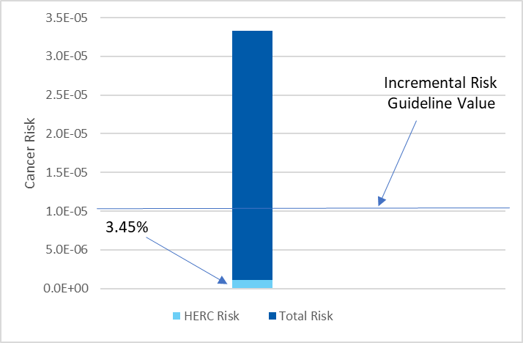
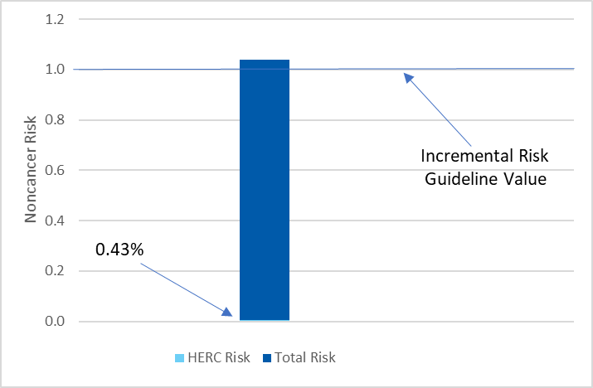
Result of risk analysis by census tract
1262 – North Loop
Cancer Risk
Noncancer Risk
Note: % represents HERC contribution as a fraction of Total Risk
Notes:
We will start with the North Loop census tract which is the area directly surrounding HERC. These graphs compare HERC’s contribution (red) to total risk (blue) as a percentage of total risk. The total risk is associated with all other sources (other point sources, non-point sources, mobile sources). The left graph shows the cancer risk and the right graph shows the non-cancer risk. Both charts identify the incremental risk guideline value as a blue line. The total cancer risk is approximately 3.25X10-5 or 3.3 people in 100,000 which is 3 times over the incremental risk guideline level. HERC’s emissions make up 3.45% of that estimate. For non-cancer, the total risk is slightly above 1 and HERC’s emissions make up 0.43% of that total.
I want to point out that in the hypothetical case of HERC shutting down, removing the red bar of HERC’s contributions would not resolve the remaining cancer or non-cancer risk. As we review the other census tract results, you will see this pattern repeated.
Emission graphs showed about 83,000 lb of HCL per year, and 0.003 lb of dioxin. Dioxin is the primary driver of cancer risk, non-cancer risk from HCL and dioxin are on a similar scale and the majority of the risk driver

Slide 42
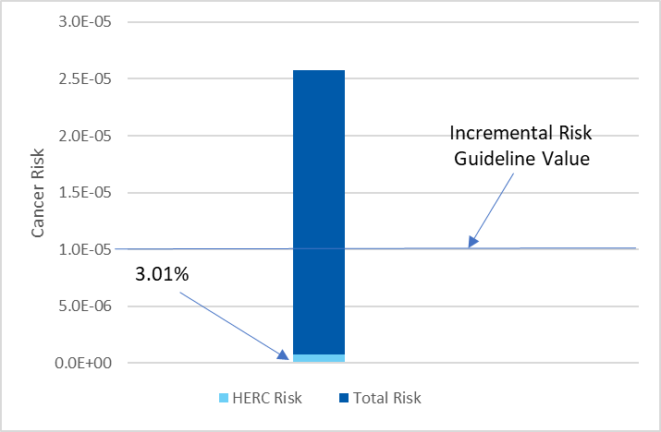
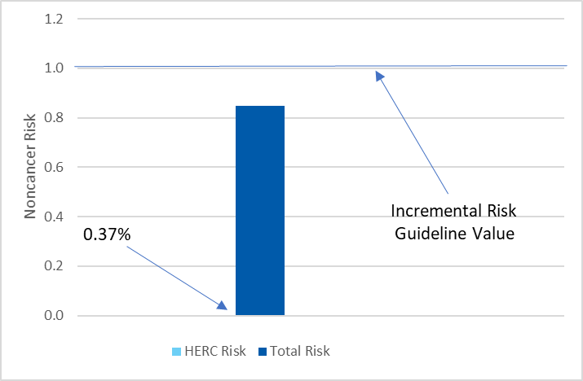
Result of risk analysis by census tract
1034 – Sumner Glenwood
Cancer Risk
Noncancer Risk
Note: % represents HERC contribution as a fraction of Total Risk

Slide 43
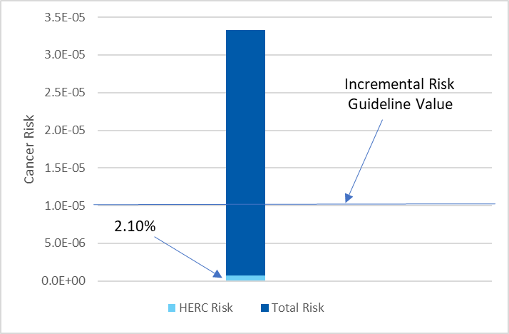
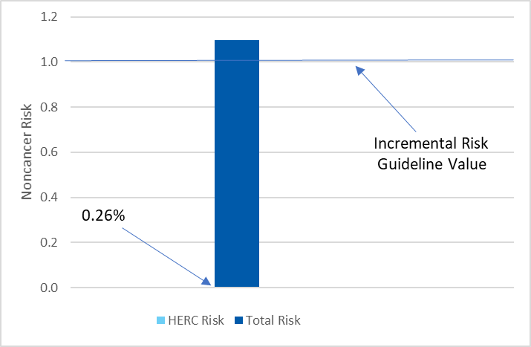
Result of risk analysis by census tract
1036 – St. Anthony West/Nicollet Island-East Bank
Cancer Risk
Noncancer Risk
Note: % represents HERC contribution as a fraction of Total Risk

Slide 44
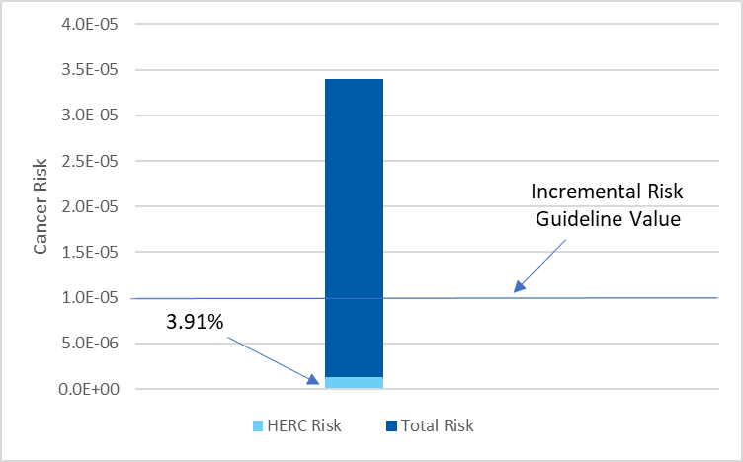

Result of risk analysis by census tract
1261 – Downtown West/East
Cancer Risk
Noncancer Risk
Note: % represents HERC contribution as a fraction of Total Risk

Slide 45
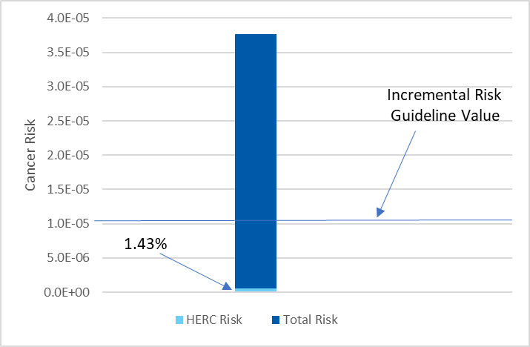
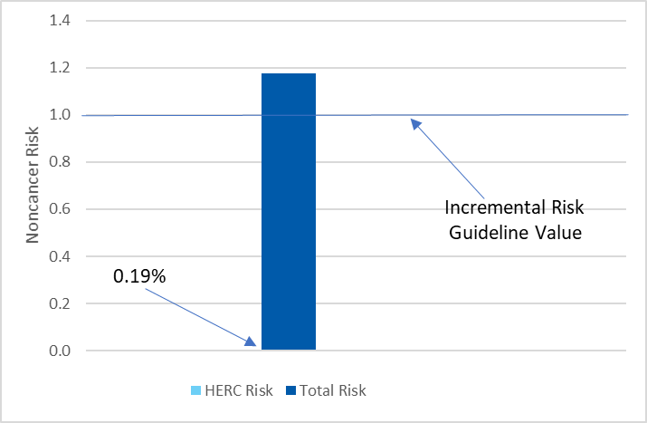
Result of risk analysis by census tract
1052.01 – Loring Park
Cancer Risk
Noncancer Risk
Note: % represents HERC contribution as a fraction of Total Risk

Slide 46
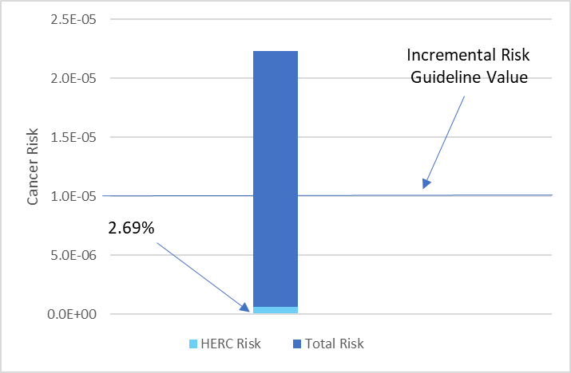
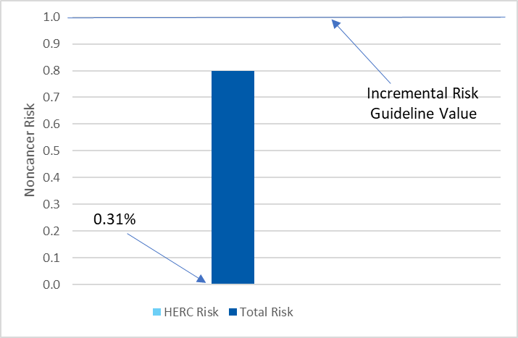
Result of risk analysis by census tract
1028 – Near North/Willard-Hay
Cancer Risk
Noncancer Risk
Note: % represents HERC contribution as a fraction of Total Risk

Slide 47
Conclusions
The cancer and non-cancer risks from HERC emissions by themselves are well below Minnesota Department of Health incremental risk thresholds
Emissions from mobile and non–point sources pose much higher risks to human health than emissions from HERC
HERC is not likely to cause more harmful cancer or non-
cancer health effects in one part of the community than another
(equally low impact on surrounding communities)
Notes:
To summarize our findings, from a risk perspective The cancer and non-cancer risks from HERC emissions by themselves are well below Minnesota Department of Health incremental risk thresholds. This result makes sense since as a permitted point-source facility, HERC is not allowed to emit pollutants in amounts that would increase cancer or non-cancer risks above incremental risk thresholds. MPCA would not issue a permit to HERC if they had data that said they did. This is why MPCA requires permits for point sources – to require the emissions controls to avoid an adverse health impact.
The overall emissions in Hennepin County are dominated by mobile and non-point sources, which makes those sources more likely to have greater impacts on the total risk in the area. Our results only looked at HERC specific contributions, not all point source contributions to the total risk, however, the MPCA’s Understanding Environmental Justice in Minnesota website has it broken out by source type and in most census tracts, the primary source of the total risk is traffic emissions.
The overall impact from HERC’s emissions was negligible by itself, and especially when compared with the current background cancer and non-cancer levels.
When looking at MnRISK, HERC is not likely to cause more adverse cancer or non-cancer health effects in one population than in others (similar and low impact to all populations)

Slide 48
References
MDH. 2018. Brief Update on Cancer Occurrence in East Metro Communities. https://www.health.state.mn.us/data/mcrs/docs/rpteastmetro.pdf
Minneapolis Health Department. 2016. Air Quality in Minneapolis: A Neighborhood Approach – Executive Summary. Minneapolis Health Department. https://www2.minneapolismn.gov/media/content-assets/www2-documents/government/Air-Quality-Study-Executive-Summary.pdf
MPCA. 2003. Air Toxics Monitoring in the Twin Cities Metropolitan Area. Preliminary Report. https://www.pca.state.mn.us/sites/default/files/lr-airtoxmonitoring-1sy03.pdf
MPCA. 2003. Personal exposure to PM_{2.5} in Minneapolis-St. Paul. https://www.pca.state.mn.us/sites/default/files/environmentalbulletin-0803.pdf
MPCA. 2016. 2013-2015 Community Air Monitoring Project Final Report. https://www.pca.state.mn.us/sites/default/files/aq8-35.pdf
MPCA. 2017. MNRISKS: Minnesota Statewide Screening of Human Health Risks from Air Pollution. https://www.pca.state.mn.us/sites/default/files/aq9-29.pdf
MPCA. 2021. 2022 Annual Air Monitoring Network Plan for Minnesota. https://www.pca.state.mn.us/sites/default/files/aq10-20a.pdf
MPCA. Neighborhood Sources.www.pca.state.mn.us/air/neighborhood-sources
MPCA. Sources of air pollution. www.pca.state.mn.us/air/sources-air-pollution
USEPA. 2016. Technical Guidance for Assessing Environmental Justice in Regulatory Analysis.
https://www.epa.gov/sites/default/files/2016-06/documents/ejtg_5_6_16_v5.1.pdf
USEPA. 2021. Conducting a Human Health Risk. www.epa.gov/risk/conducting-human-health-risk-assessment

Slide 49
Learn more: www.hennepin.us/HERC
David McNary, Assistant Director, Solid Waste Division
Hennepin County Environment and Energy
David.McNary@hennepin.us

